Slide 1
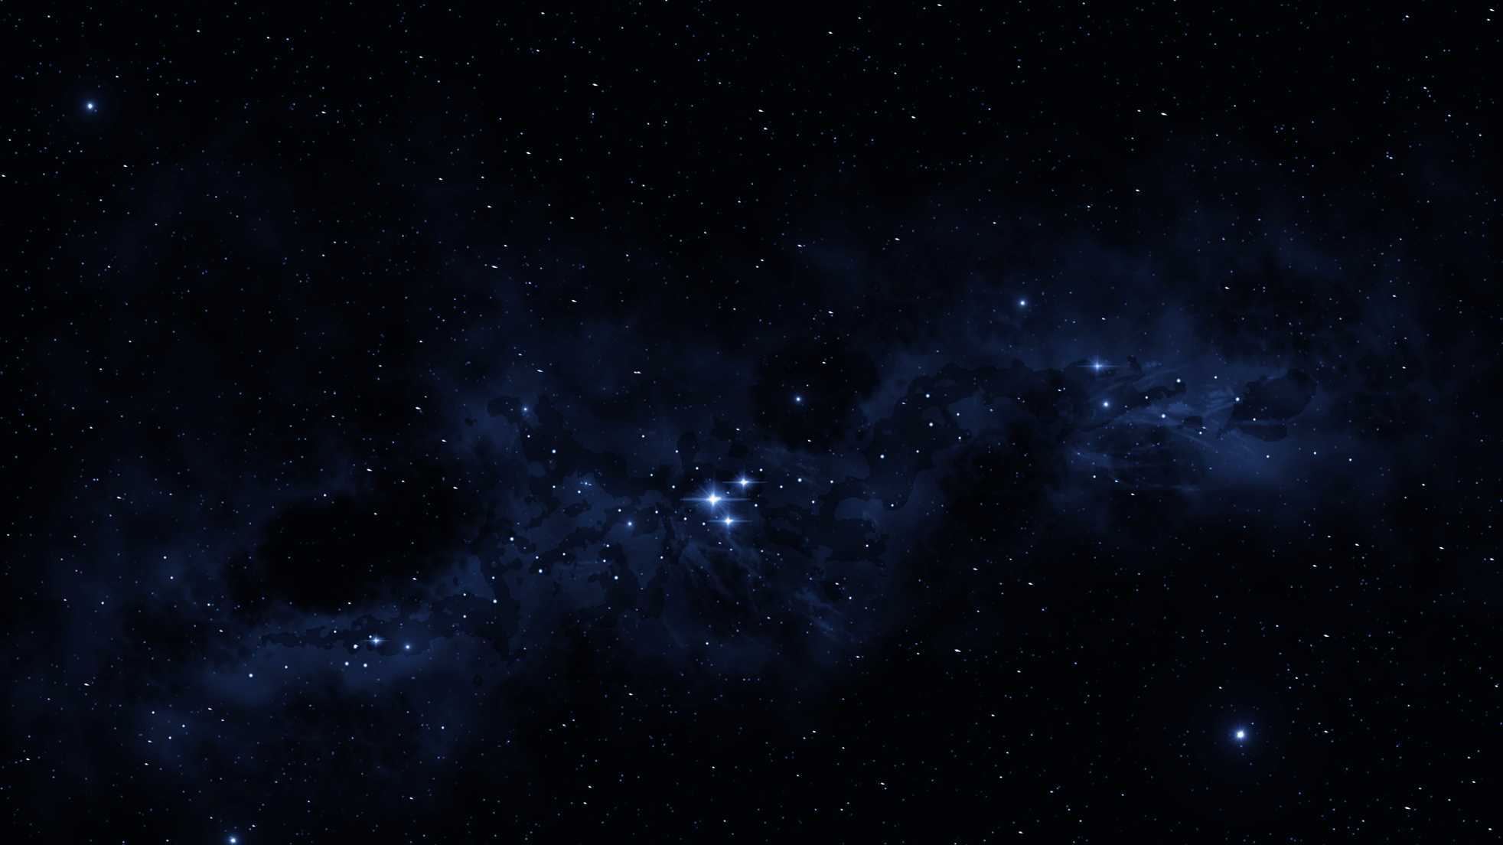

Sky's Diamond
Let the stars lead the way.
Dimosthenis Minas
Evangelos Kouros
Ioanna Styliani Ellina
Michalis Ioakeimidis
NASA's Space App Challenge
TWINKLE, TWINKLE, LITTLE STAR

Slide 2
Our challenge: Twinkle Twinkle little star
The main purpose of our challenge was to help people understand that the stars in the night sky are always changing, but usually too slowly or by too little for the eye to see.
Our Idea
Information Tool: Web-based application which includes information page about stellar variability.
Ability to check your knowledge after being informed thoroughly through quizzes with different level of difficulty, created upon certified resources from people all over the world.

Slide 3




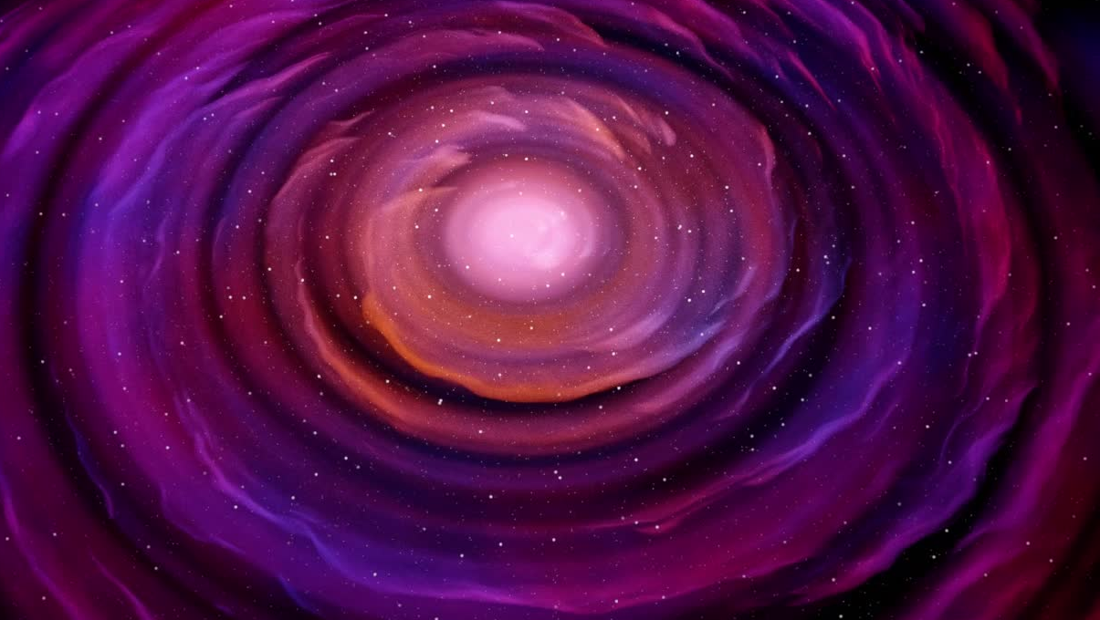
Our Impact
Addressed to Schools - Universities as an information-motivation tool More and more youngsters will be inspired to be involved in this field
Accessible to people who want to be informed about the stars' variation
Employees in Space Agencies or Space-related companies who would like to elaborate or share their knowledge

Slide 4
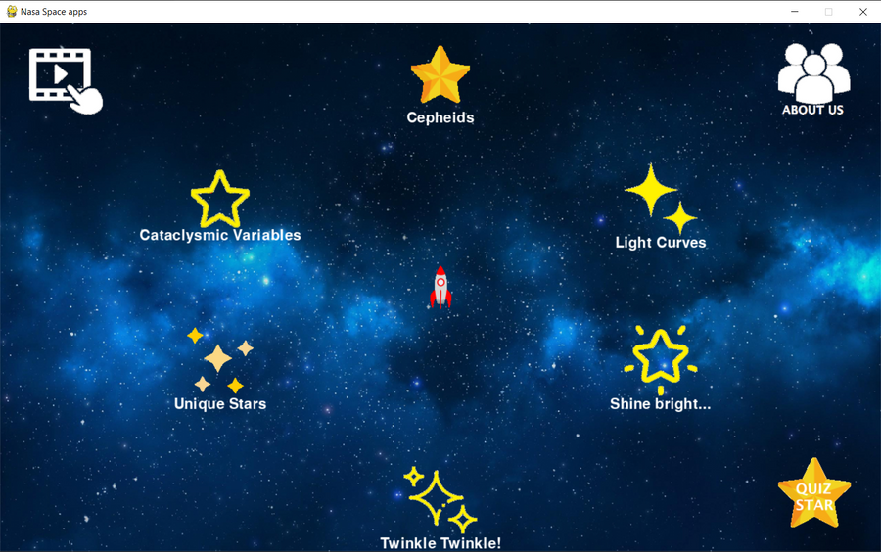
How does it work?
Our current program can be presented in the picture below. The user can move through the keyboard's arrow, as a rocket towards the location that he wants to be informed about.
There is the ability to be informed about twinkling stars, the brightness and uniqueness of stars as well as more complicated terms such as cepheids, light curves and cataclysmic values.

Slide 5

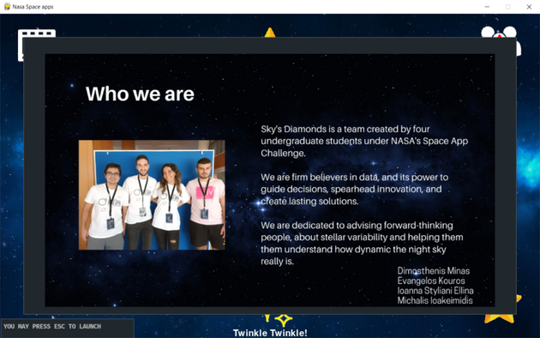

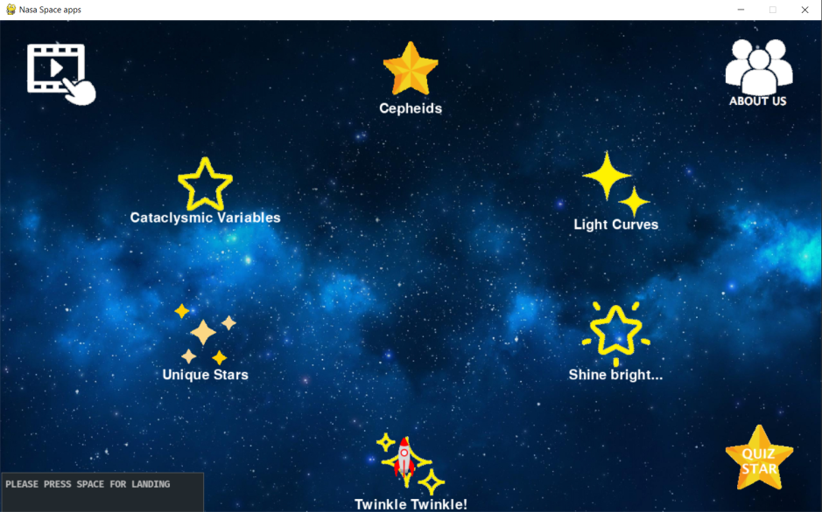
Our project
We developed a safe and intuitive environment based in Python (for all ages) to learn and explore the universe through a game.

Slide 6
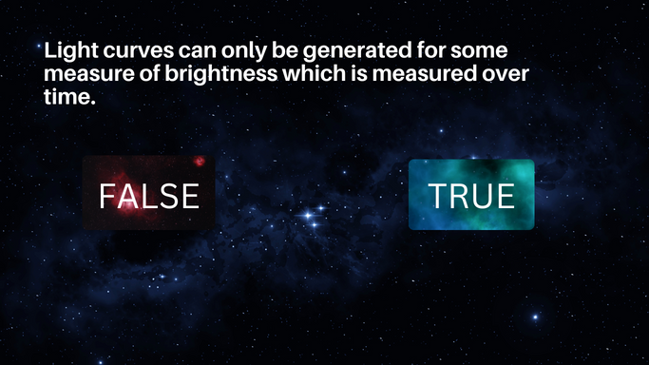
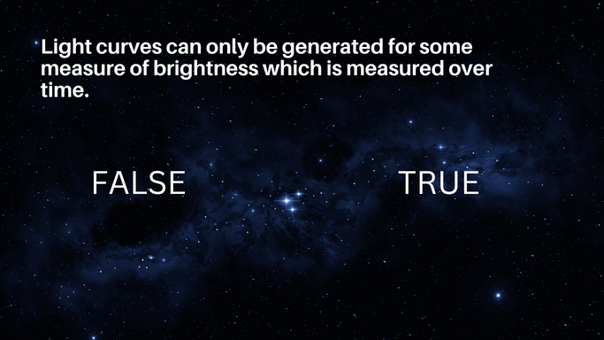
Our project-Quiz
As mentioned above, our app has the possibility of quizzes if you press the Star Quiz symbol.
After every answer, the correct answer is shown in the screen. After taking all the answer quizzes, the final result is estimated and appears in the screen to inform you about your score.

Slide 7

Future work
The ideal project if we had more time, would be the creation of a web-page where everyone could be informed through some educational videos and scientific articles. We would also suggest that this web page introduces online lectures from people from all over the world that could inform us about stellar variation . Adding information for both amateurs and professional lovers of this field.
https://skysdiamonds.my.canva.site/

